Slide 1
Secure
System for She (SSS)

Slide 2
The opportunity
We believe that cities must be made safer and more inclusive for women and everyone. Proposing idea is the women centered community based platform, Mobile application with the integration of wireless bluetooth device & AI recommender system based on safe or non-safe routes & places for women who self - drive to work.

Slide 3
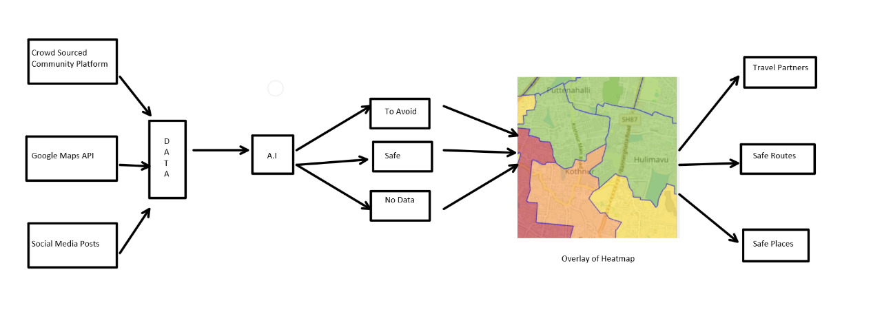
The solution pipeline

Slide 4
Contd..
Women centered community based platform is mainly focusing on building a community of working women which can enable the women to share their opinions on safer routes, to find travel partners, and also to collect the data through crowdsourcing.

Slide 5
Flow of community platform
User creates a profile including personal details, company location, mode of transportation, starting point.
AI recommeder system will recommend the users to share the vehicle based on profile matching.
We'll have public forum to share reviews on places and private chat option as well to connect with and find travel partner.
We'll enable users to upload the pictures in order to Crowdsource the data based on parameters like security, openness, visibility, lightning during night times, gender population.

Slide 6
Mobile app and integration of AI model.
With the computer vision model we'll be doing scene classification, face recognition (to get count of male and female) based on location filer in order to classify location as safe & unsafe.
With the NLP models we'll be extracting the sentiment of the captions of the social media posts.
We generate the heat maps based on these features which we'll overlay on the Google maps in order to show the safe routes and locations for the user.

Slide 7
Mobile application integration with wireless Bluetooth device
In order to provide instant user interaction

Slide 8
The business model
We run a community based business model.
Initially we won't be monetizing the platform.
We would be monetizing the platform once we partner with the regional resturants, hospitals etc..

Slide 9
Go to market strategy
Creating social awareness through women centered initiatives
Collaboration with technical meetups.
Social media campaigning (Tag the friends, Social photo contest, weekly #tags).
Collaboration with police departments.
Partnering with regional restaurants, hospitals, petrol bunks to endorse on our platform.

